Slide 1

METODOLOGI PENELITIAN Semester Ganjil 2023-2024 MP-07-BAB III, IV dan V
Program Studi S-1 Teknik Informatika
FMIPA Universitas Padjadjaran

Slide 2
JUDUL BAB
Bagi yang memilih skripsi yang berkaitan dengan pengembangan sistem informasi
Judul Bab : BAB III ANALISIS DAN DESAIN
Bagi yang memilih skripsi yang berkaitan dengan implementasi metode informatika
Judul Bab : BAB III METODE PENELITIAN

Slide 3
BAB III METODE PENELITIAN
Berisi
Blok diagram yang berisi sistematika/langkah-langkah penelitian yang akan dilakukan
Penjelasan mekanisme dari setiap blok, proses, metode, dan penerapan formula, software/library yang digunakan
Penjelasan data yang akan digunakan, bagaimana mengumpulkannya
Penjelasan cara mengukur keberhasilan metode

Slide 4
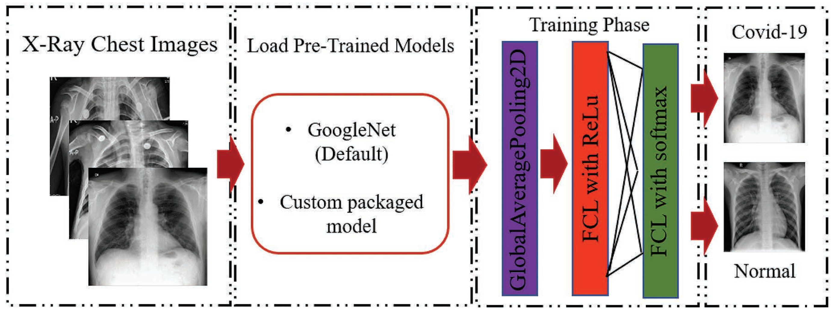
Contoh Sistematika

Slide 5
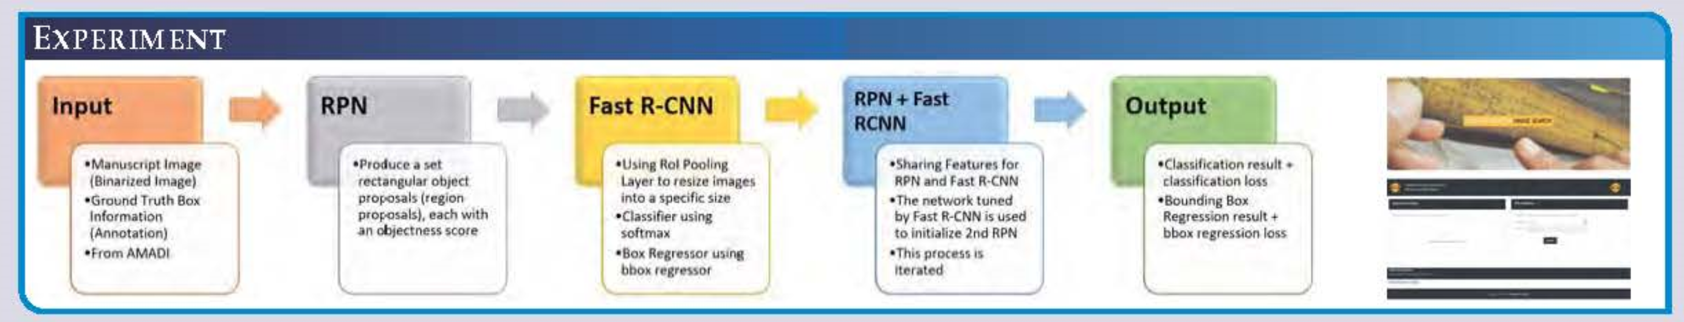
Contoh Sistematika

Slide 6
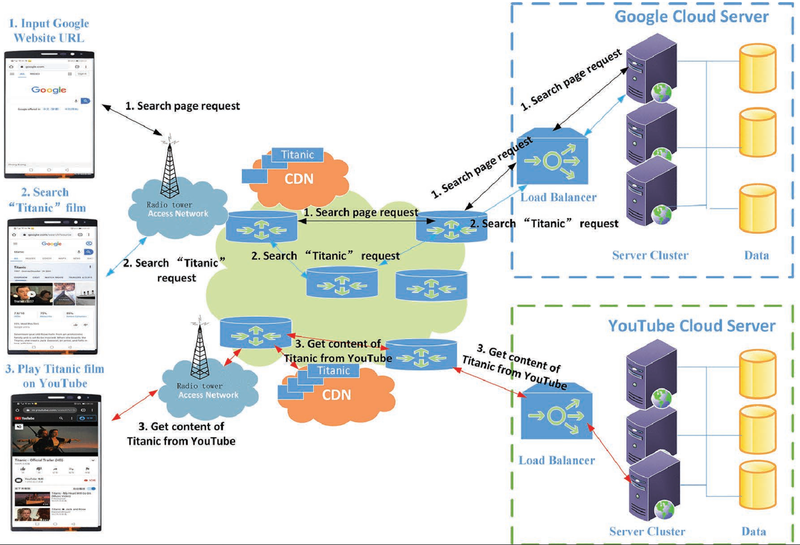

Slide 7
BAB III ANALISIS DAN DISAIN
Berisi
Tahap Analisis Sistem
Penjelasan dari existing system yang berjalan sebelumnya ditinjau dari sisi input proses dan output, organisasi/objek
Evaluasi sistem yang sedang berjalan
Kekurangan dan kelemahan sehingga diperlukan pengembangan sistem baru (komputerisasi)
Penjelasan tentang kebutuhan sistem yang akan dikembangkan
HW, SW, BW, Database
Perancangan Sistem
Input
Proses
Outout
Pengukuran Keberjalanan Sistem

Slide 8
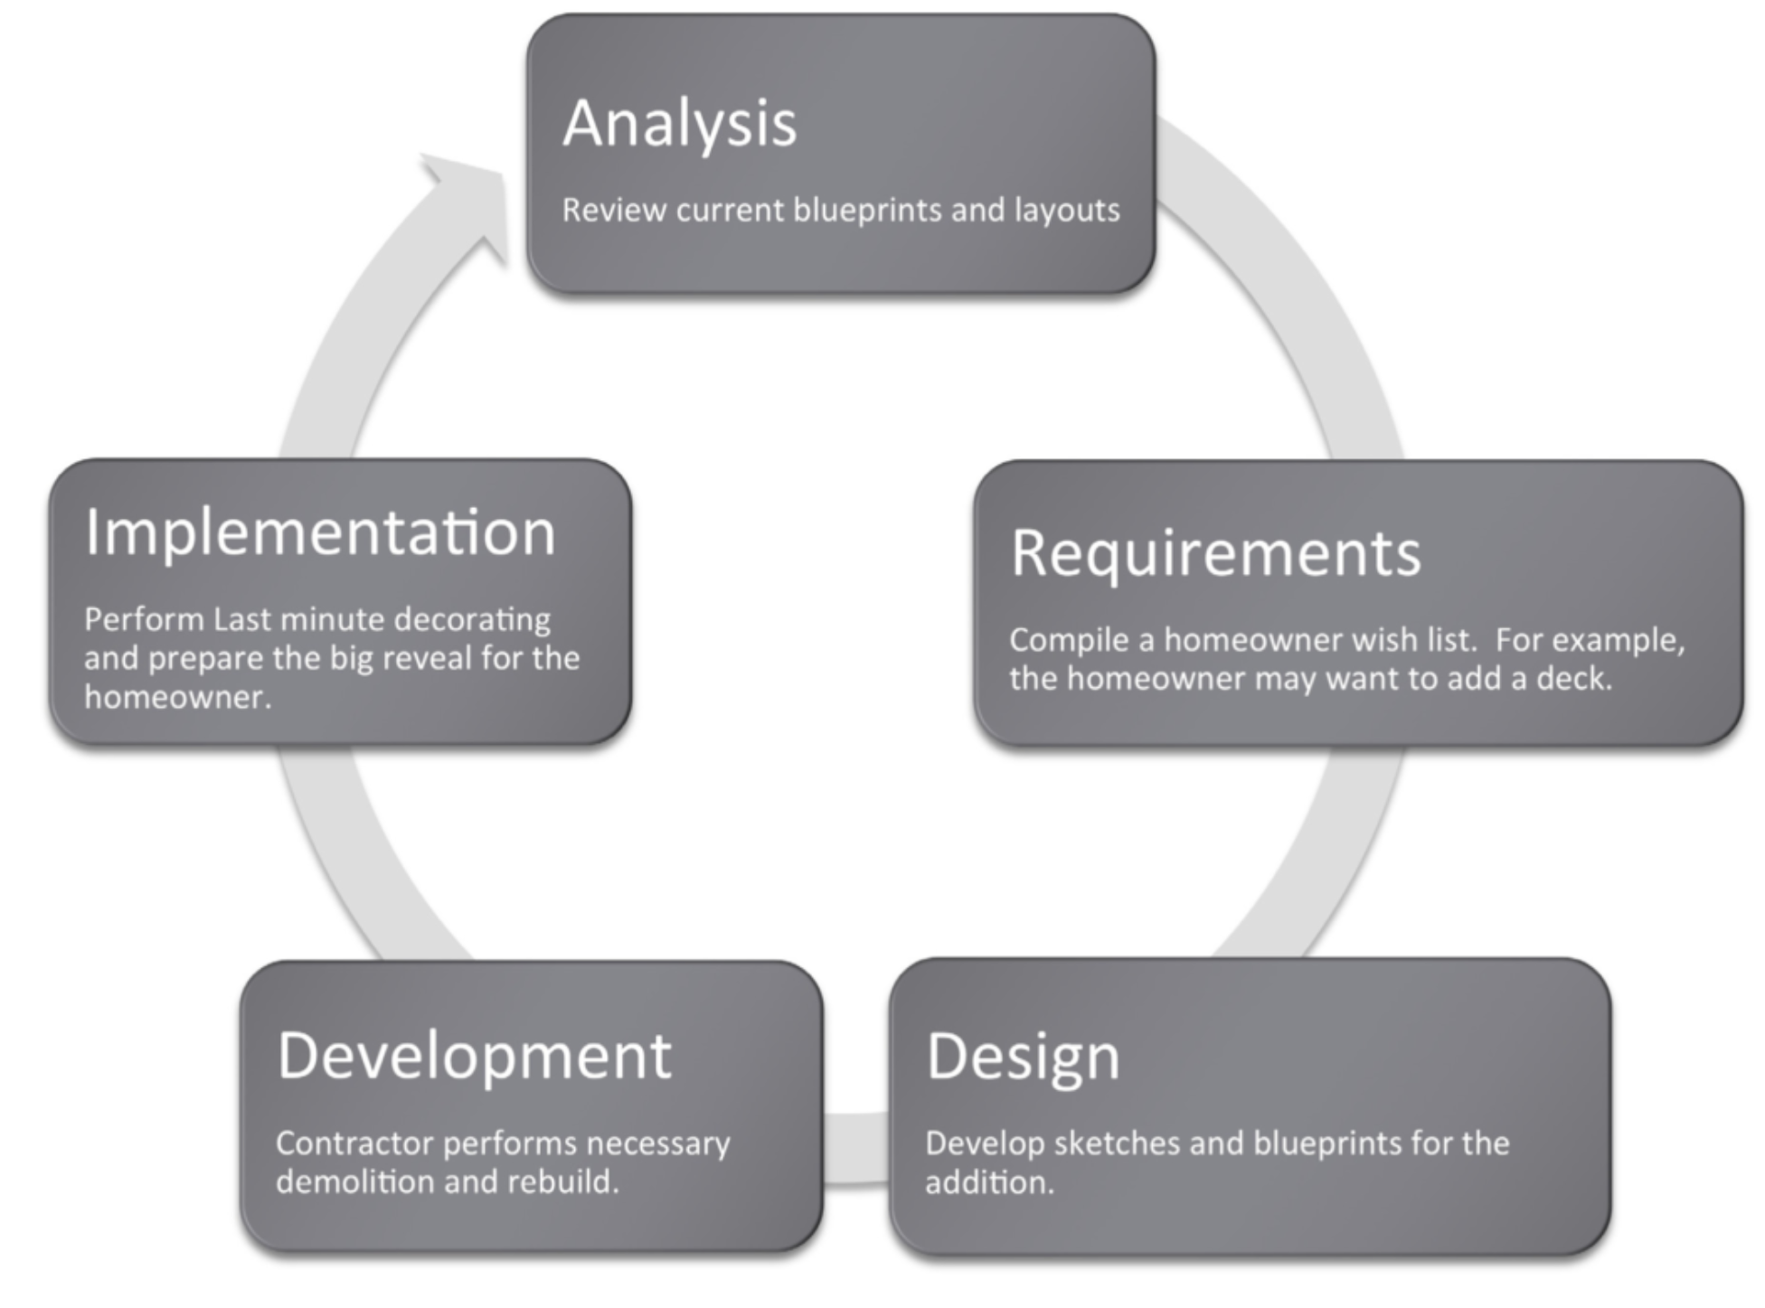
Contoh Sistematika

Slide 9
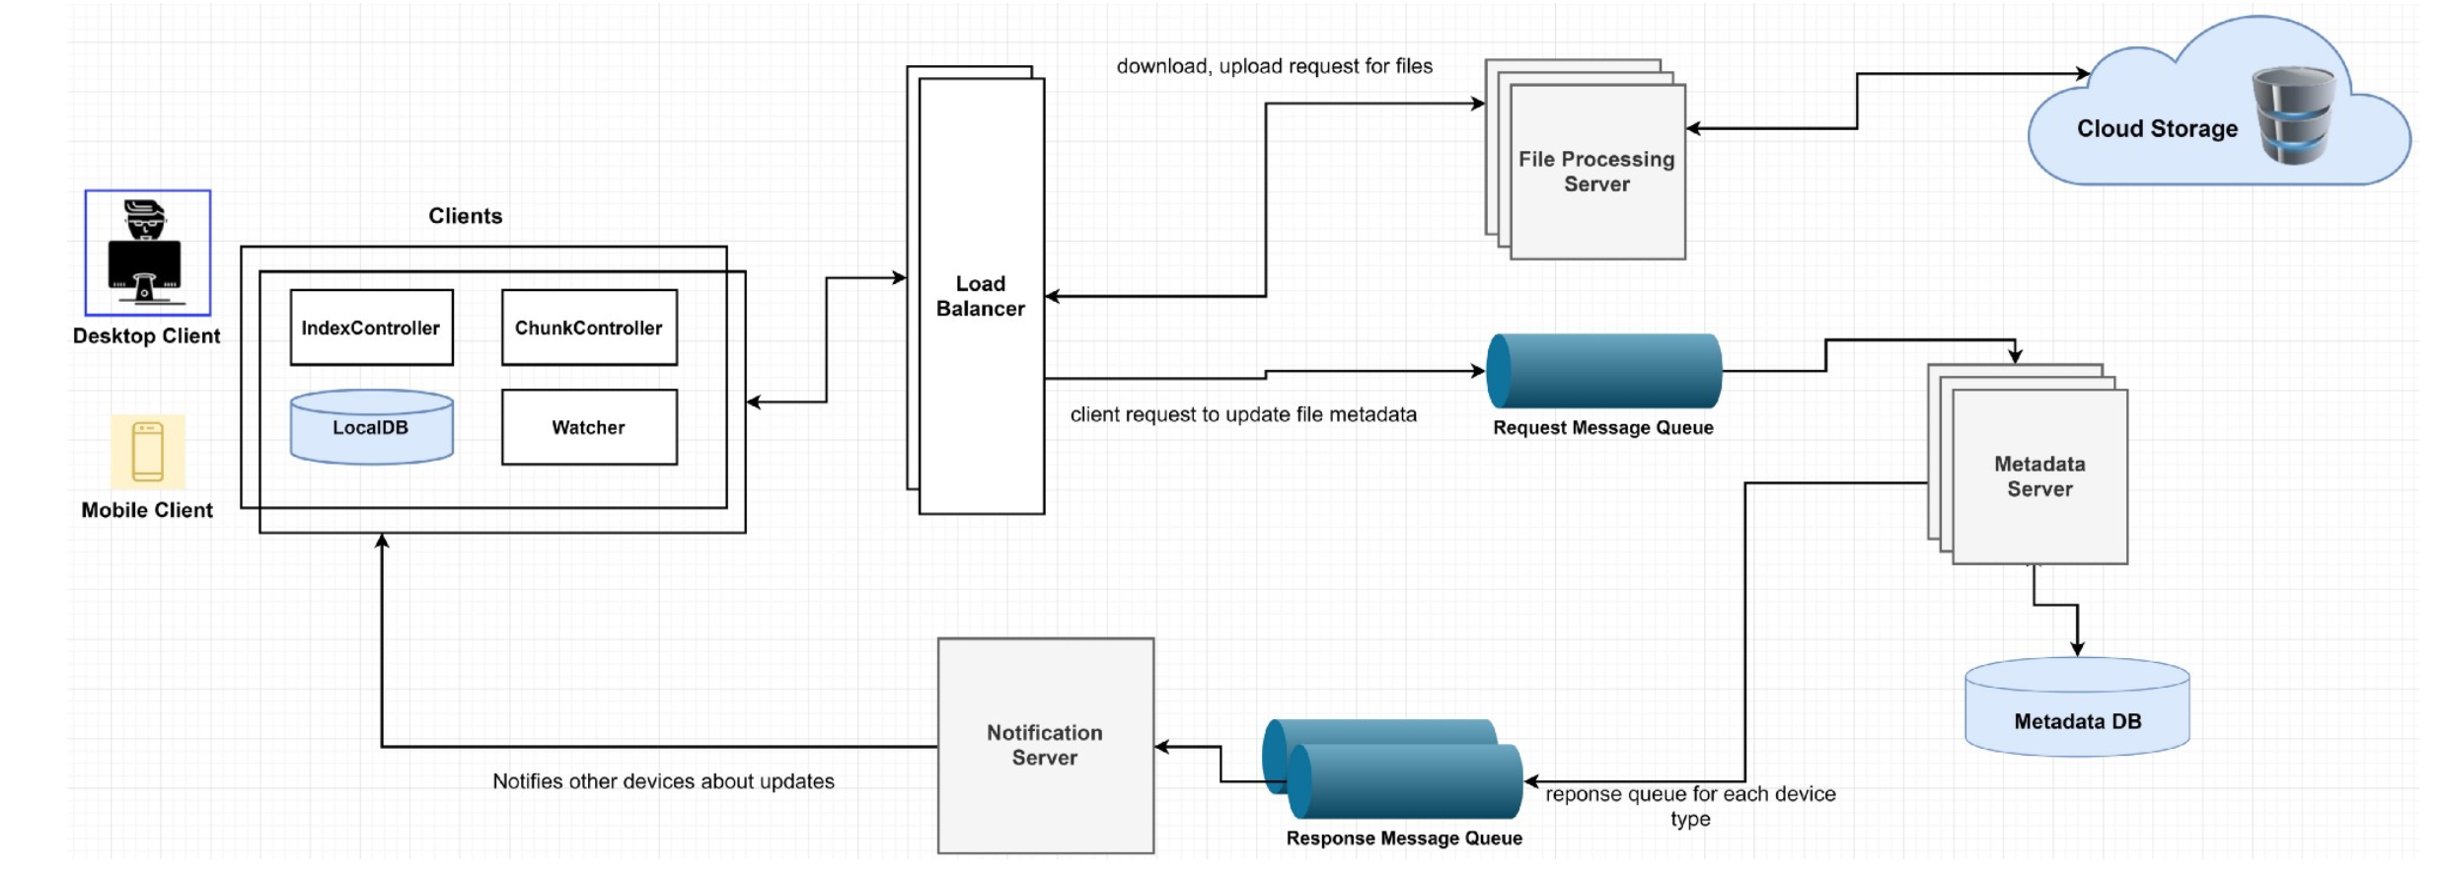
Contoh Lain

Slide 10
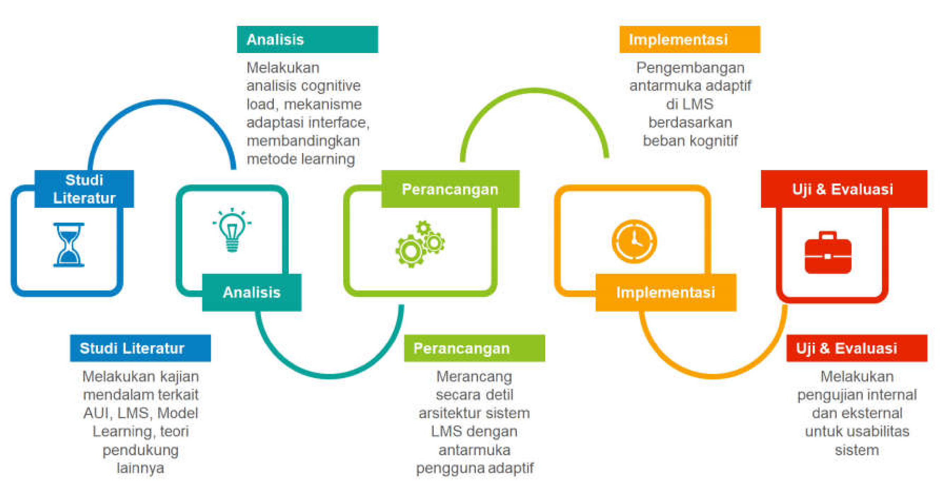
Contoh Lain

Slide 11
Contoh Lain dalam Pengembangan Sistem Informasi
BAB III
Feasibility Study – the stage where information analyst makes a study of whether the managements’ concept of having the desired new system is achievable. It may be that development of a new system is not needed instead an update of the existing is enough.
Analysis – the stage where users and IT specialists work together to collect and comprehend the business requirements. Based on requirements, both will work on the design and discuss the tasks to be done.The user and IT specialists signs on the joint application design to formalize the business requirements.
Design – the stage where the system’s blueprint is created. The technical architecture is designed which includes telecommunications, hardware and software suited for the system
BAB IV
Development and Testing – the stage where building of the technical architecture, database and programs are executed. It is also the stage where the system is tested using the established test scripts and compare the expected outcomes to actual outcomes.
Implementation- the stage where system is in place and is used by the actual workforce. User guide manual and training are provided to users.
Evaluation – the stage where system need to be evaluated for any bug from time to time.
Maintenance- the stage where system needs to be enhanced or strengthened in order to meet the goals of the organization.

Slide 12
BAB IV dan BAB V
Metode informatika
BAB IV HASIL DAN PEMBAHASAN
Test bed program implementasi metode, termasuk penjelasan program komputer
Hasil pengukuran kinerja metode
Perancangan Sistem Informasi
BAB IV IMPLEMENTASI
Berisi tampilan hasil pengembangan dan implementasi sistem yang dibuat
Input – Proses – Output, meliputi source code
Penjelasan basisdata
Hasil uji keberjalanan sistem
Kesimpulan dan Saran
BAB V SIMPULAN DAN SARAN

Slide 13
BAB IV (PROPOSAL SKRIPSI)
Lokasi Penelitian
Jadwal Penelitian

